Slide 1
Simulation of Crude Oil Exploration & Production
By Aditya Sastry

Slide 2
Project Overview
1

Slide 3
The Petroleum Industry
Upstream
The process of exploring potential oilfields and producing crude oil and natural gas when discovered
(E&P)
Midstream
Primarily concerned with connecting the upstream and downstream with transportation and storage as well as some processing
Downstream
Refining the products, marketing, and point of sale operations are the bulk of the downstream sector

Slide 4
Project Goals & Narrative
A firm is interested in drilling a single onshore well for crude oil in Northern Texas
Analyze the costs of Exploration in detail
Forecast the price of crude (WTI-spot)
Generate production forecasts and costs
Understand NPV of entire E&P operation
5 years to break even

Slide 5
E&P Model
2

Slide 6
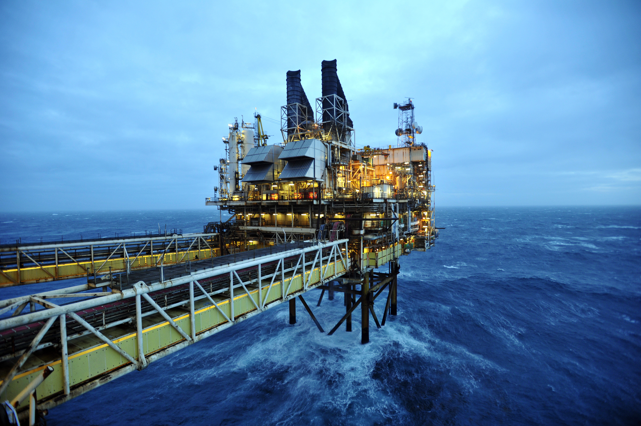
Exploration Simulation

Slide 7
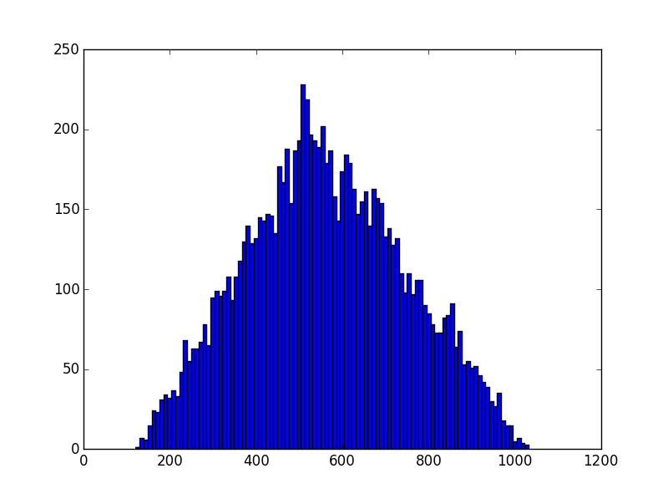
Pre-Hydrocarbon Discovery
Seismic Methods
Consecutive swatches of land are scanned in 2D or 3D to provide an understanding of the geology of the area. Costs are driven by the dificulty of the terrain and technology used. Analysis and processing costs added.
Seismic Cost
Frequency n = 10,000
$ 1000 s
$ 1000 s

Slide 8
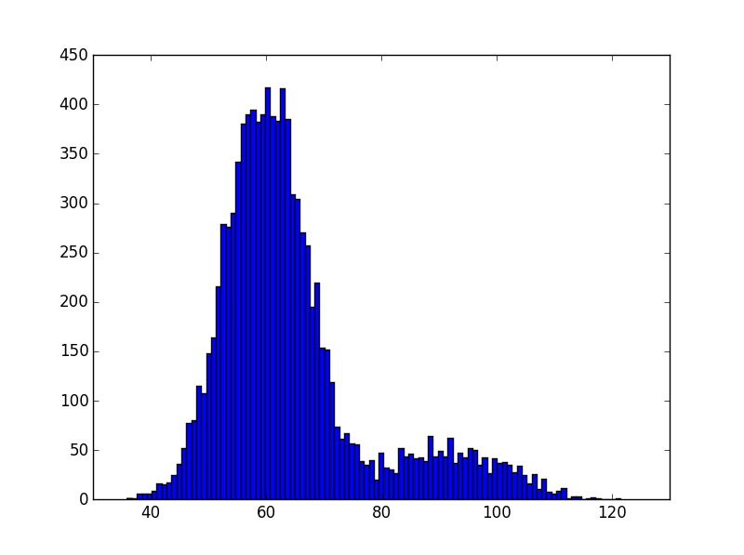
Exploratory Well
Drilling Time
The major cost of well drilling is the labor and equipment. Drilling prices are quoted in “dayrates,” a contract cost per day.
Drilling Time
Frequency n = 10,000
Days

Slide 9
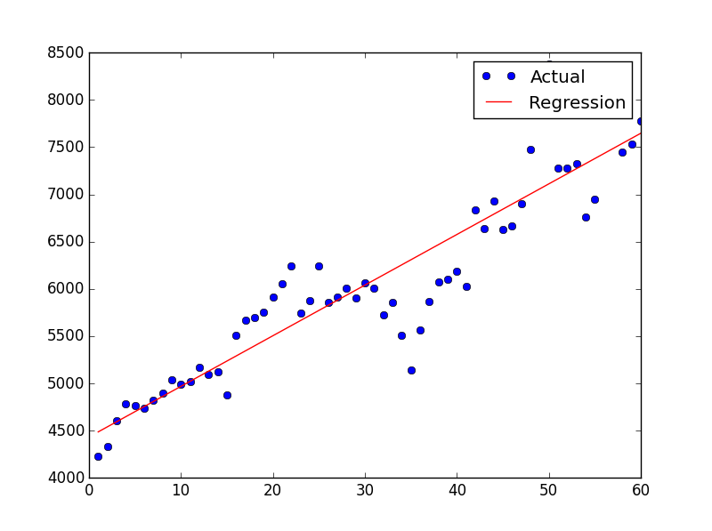
Exploratory Well
Drilling Depth
A driver for numerous other exploratory costs, the depth of well is important to estimate.
2016 Estimate
Point Forecast: 8075 ft
95% Interval:{7819 ft, 8332 ft}
Drilling Depth vs. Time
Depth
Time (1949-2008)

Slide 10
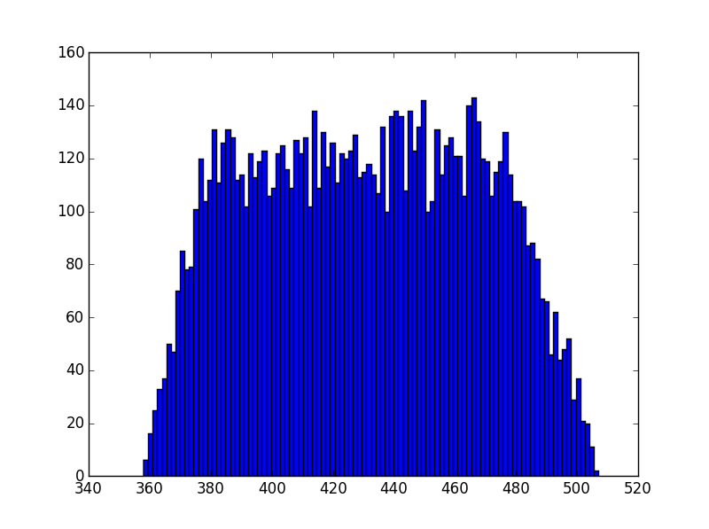
Logging
Mud Analysis
During and following exploratory drilling, samples of mud and extracted rock are continuously analyzed. The cost of these geological tests are based on drilling depth.
Logging Cost
Frequency n = 10,000
$ 1000 s

Slide 11
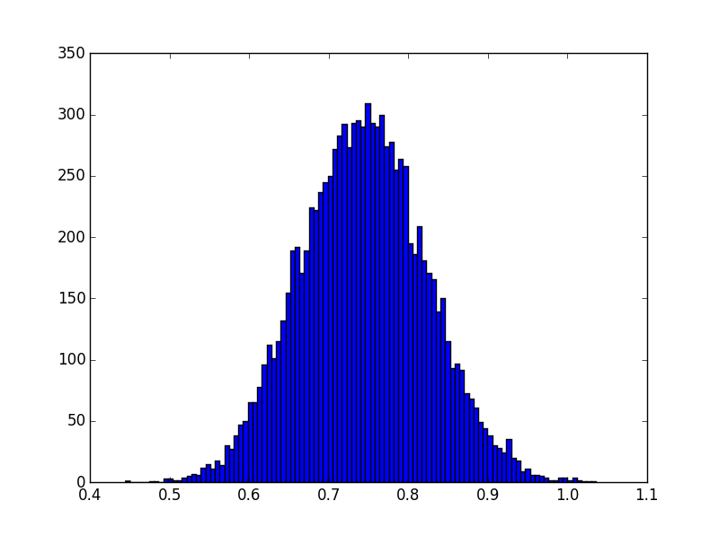

Probability of Finding Oil
Dry Hole Risk
Distinct chance of not finding any extractable crude oil.
Successful Well Probability
Frequency n = 10,000
Probability

Slide 12
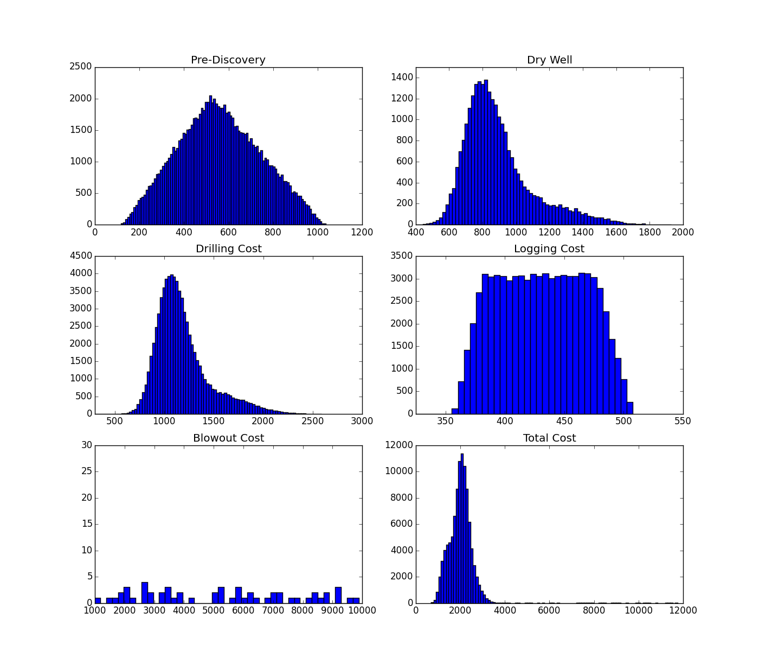
Exploration Simulation
Simulation Parameters
-100,000 Iterations
-0.049% Blowout Probability
Total Cost Descriptive Statistics
min: 691.92 mean: 1988.20 max: 11747.77 std dev: 468.40 var: 219401.02

Slide 13
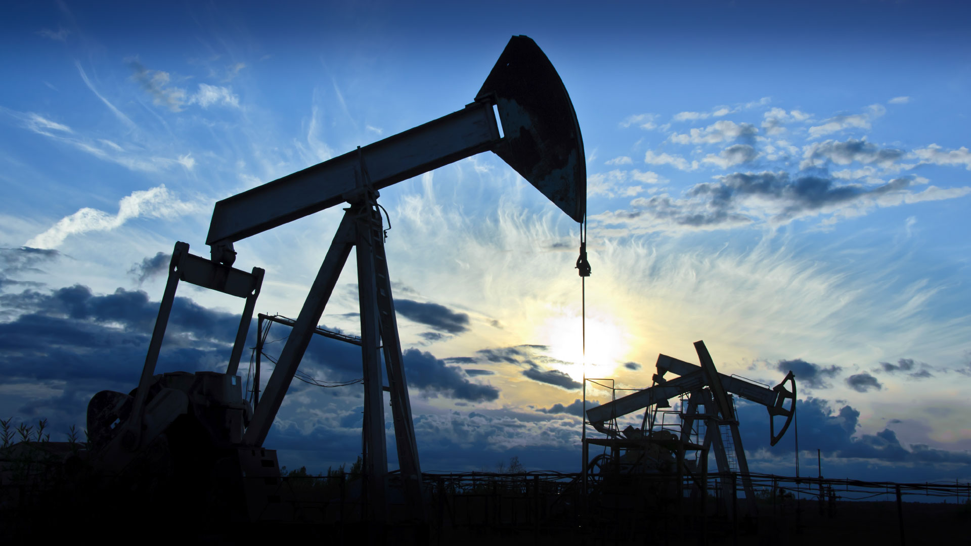
Production Simulation

Slide 14
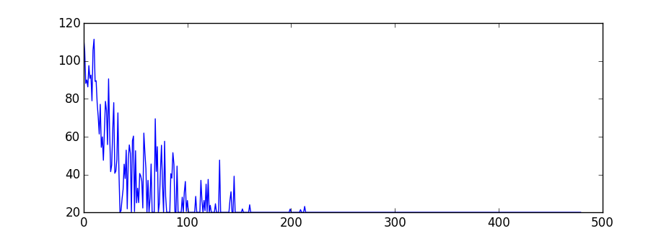
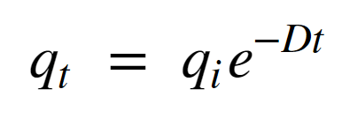
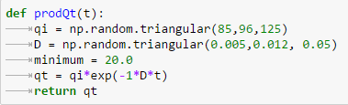
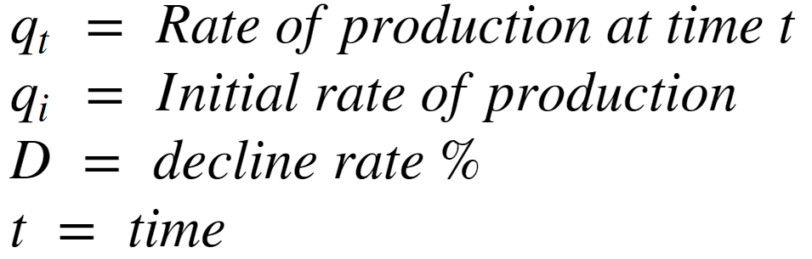
Production Duration
Production Over 2 Years
Exponential Decline
As crude oil is extracted, the pressure from the water content decreases resulting in decline production
Barrels Per day
Days

Slide 15
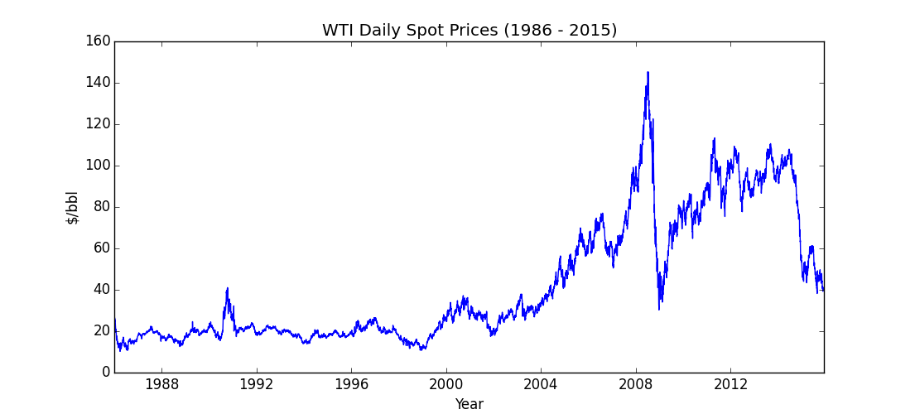
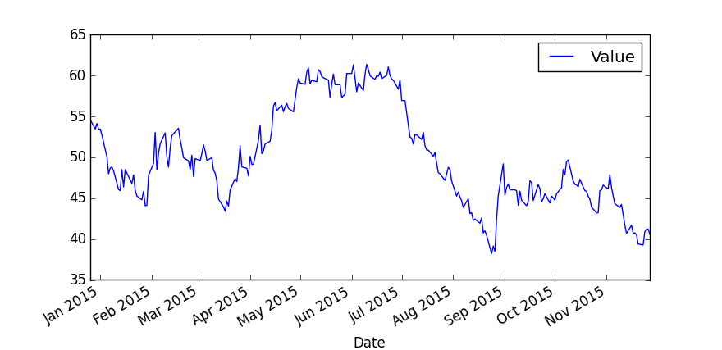
Oil Price
West Texas Intermediate
Produced oil will be marked to the WTI spot price on a daily basis, and discounted to the present at the 10 year Treausry rate
WTI Daily Spot Prices (1/15-12/2/15|)

Slide 16
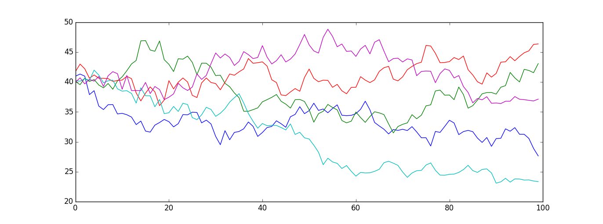
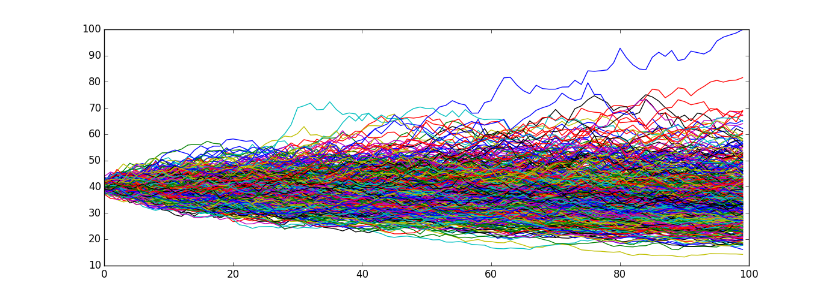
Oil Price
N = 5
Geometric Random Walk
Due to the discussed recent changes, this model was implemented to simulate the price path of the asset in a conservative manner
N = 500

Slide 17
$-2,198,004

Slide 18
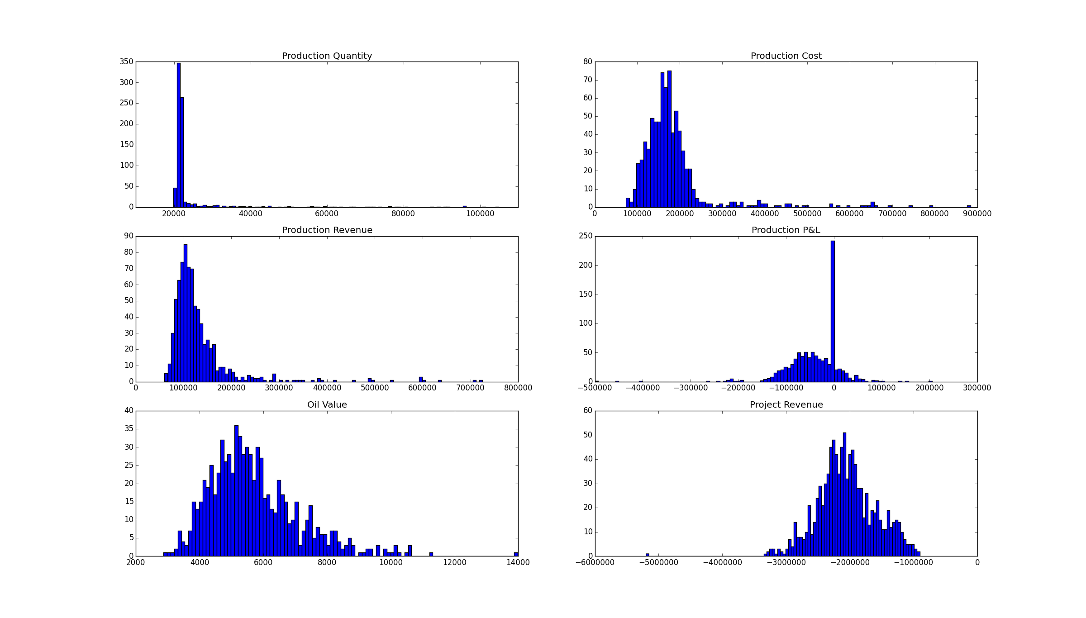
Final Simulation

Slide 19
Exploration Simulation
Simulation Parameters
-100,000 Iterations
-0.049% Blowout Probability
Total Cost Descriptive Statistics
min: 691.92 mean: 1988.20 max: 11747.77 std dev: 468.40 var: 219401.02

Slide 20
Conclusion
Exploration is EXPENSIVE
Optimizing for oil price at T=0 as wel as years of production still made profit unlikely
Production Decline is FAST
Increasing the time of production greatly does not contribute much to revenue
Dry Holes
In the current economy, any project that is started is likely better off not finding oil
Oil Prices
Using previous “stable” values of $80 and $100 resulted in much more favorable estimates
Simulation Parameters
Computational limits made simulating past 1500 iterations for the final Monte Carlo challenging
Assumptions
This model assumes to know things many years away. Is best used on an ongoing basis.

Slide 21
Thanks!
Any questions ?

